Slide 1

COMPUTER NETWORKS
Sivaraman Eswaran Ph.D.
Department of Computer Science and Engineering

Slide 2

COMPUTER NETWORKS
Computer Networks and the Internet
Sivaraman Eswaran Ph.D.
Department of Computer Science and Engineering

Slide 3








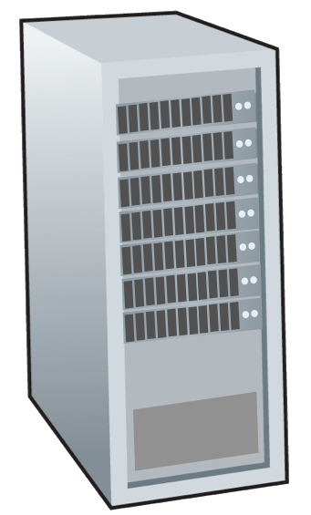







COMPUTER NETWORKS
Network Core
mesh of interconnected routers
packet-switching: hosts break application-layer messages into packets
forward packets from one router to the next, across links on path from source to destination
each packet transmitted at full link capacity
mobile network
national or global ISP
local or regional ISP
home network
content
provider
network
datacenter
network
enterprise
network

Slide 4




COMPUTER NETWORKS
Network Core: Packet Switching: store-and-forward
L bits
per packet
source
3
2
1
destination
R bps
R bps
Transmission delay: takes L/R seconds to transmit (push out) L-bit packet into link at R bps
Store and forward: entire packet must arrive at router before it can be transmitted on next link
End-end delay: 2L/R (above), assuming zero propagation delay (more on delay shortly)
One-hop numerical example:
L = 10 Kbits
R = 100 Mbps
one-hop transmission delay = 0.1 msec

Slide 5
COMPUTER NETWORKS
Network Core: Packet Switching: queuing delay, loss
R = 100 Mb/s
C
A
R = 1.5 Mb/s
D
B
E
queue of packets
waiting for output link
Packet queuing and loss: if arrival rate (in bps) to link exceeds transmission rate (bps) of link for a period of time:
packets will queue, waiting to be transmitted on output link
packets can be dropped (lost) if memory (buffer) in router fills up

Slide 6
COMPUTER NETWORKS
Network Core: Two Key Network Core Functions
routing algorithm
Routing:
global action: determine source-destination paths taken by packets
routing algorithms
routing algorithm
Forwarding:
local action: move arriving packets from router’s input link to appropriate router output link
local forwarding table
local forwarding table
header value
output link
0100
0101
0111
1001
3
2
2
1
1
3
2
0111
destination address in arriving
packet’s header

Slide 7
COMPUTER NETWORKS
Network Core: Circuit Switching
end-end resources allocated to, reserved for “call” between source and destination
in diagram, each link has four circuits.
call gets 2nd circuit in top link and 1st circuit in right link.
dedicated resources: no sharing
circuit-like (guaranteed) performance
circuit segment idle if not used by call (no sharing)
commonly used in traditional telephone networks

Slide 8
COMPUTER NETWORKS
Multiplexing in Circuit Switched Networks: FDM & TDM
Frequency Division Multiplexing (FDM)
optical, electromagnetic frequencies divided into (narrow) frequency bands
each call allocated its own band, can transmit at max rate of that narrow band
4 users
frequency
time
Time Division Multiplexing (TDM)
time divided into slots
each call allocated periodic slot(s), can transmit at maximum rate of (wider) frequency band, but only during its time slot(s)
frequency
time

Slide 9
COMPUTER NETWORKS
Network Core: Packet Switching vs Circuit Switching
packet switching allows more users to use network!
Example:
1 Gb/s link
each user:
100 Mb/s when “active”
active 10% of time
…..
N
users
1 Gbps link
circuit-switching: 10 users
packet switching: with 35 users,
probability > 10 active users at same time is less than .0004 *
10 or few active users, probability 0.9996
Q: how did we get value 0.0004?
Q: what happens if > 35 users ?
* Check out the online interactive exercises for more examples: http://gaia.cs.umass.edu/kurose_ross/interactive

Slide 10
COMPUTER NETWORKS
Network Core: Packet Switching vs Circuit Switching
Is packet switching a “slam dunk winner”?
great for “bursty” data – sometimes has data to send, but at other times not
resource sharing
simpler, no call setup
excessive congestion possible: packet delay and loss due to buffer overflow
protocols needed for reliable data transfer, congestion control
Q: How to provide circuit-like behavior?
bandwidth guarantees traditionally used for audio/video applications
Q: human analogies of reserved resources (circuit switching) versus on-demand allocation (packet switching)?

Slide 11


COMPUTER NETWORKS
Queries

Slide 12
THANK YOU
Sivaraman Eswaran Ph.D.
Department of Computer Science and Engineering
sivaramane@pes.edu
+91 80 6666 3333 Extn 834

